Slide 1

.NET Brown Bag
Lunch
Today’s Topic:
Multithreading using
the “ProcessQueue”
Presenter:
J. Ritchie Carroll from
TRO - Control Systems
Operations Data Architecture
April 19, 2006

Slide 2

A thread, defined…
A thread is separate execution space for code that allows more than one piece of code to effectively run at the same time
Create a new procedure to be executed on a thread:
  Private Sub MyThreadProc()
  ‘ Do thread work...
  End Sub
Create a new thread:
  Dim myThread As New Thread(AddressOf MyThreadProc)
Start thread:
  myThread.Start()

Slide 3
A queue, defined…
A queue is simply an ordered collection of items
0
First item added – oldest item
1
.NET defines many ways of creating a collection of items, .NET 2.0 also provides generic collections:
Dim nameList As New ArrayList(Of String)
2
3
4
Last item added – youngest item

Slide 4
“A Process Queue”
A “process queue” combines threading with a queue to create an ordered list of items to be processed on one or more threads
0
First item added – oldest item
>> processed first
1
As with any thread, a method must be created to handle “processing” of items in the queue
Private Sub ProcessItem(ByVal item As T)
‘ TODO: Process item T
End Sub
2
3
4
Last item added – youngest item
>> processed last

Slide 5
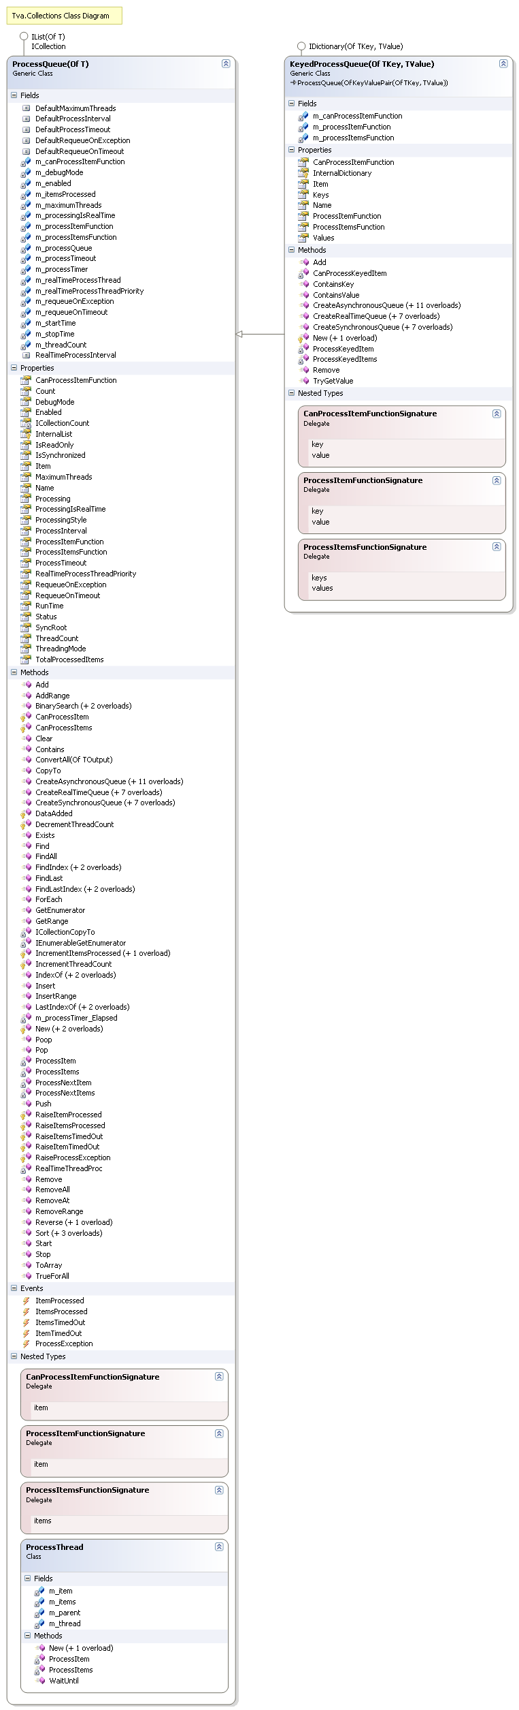
ProcessQueue(Of T)
The ProcessQueue is a class that acts as a strongly typed collection of objects to be processed in a single or multi-threaded fashion

Slide 6
Threading Modes
Synchronous – processing items in an orderly fashion one at a time
Asynchronous – processing multiple items at once when order of process completion is not important
Real-Time – special synchronous queue that processes items as fast as possible

Slide 7
Synchronous Processing
Standard steps for synchronously processing a collection of items
0
Process first item
1
Synchronous processing queues are best suited for data that must be processed in order
2
3
4
Add items to be processed

Slide 8
Asynchronous Processing
Standard steps for asynchronously processing a collection of items
0
1
Process first several items
2
Asynchronous processing queues are best suited for data that can be processed in any order
3
4
Add items to be processed

Slide 9
Threading Mode Examples
FTP file uploader – takes a collection of existing files and uploads to a web server
  Item type: File
  Order of upload is not important – multiple threads would be more efficient:
        Asynchronous
Log file class – takes ordered messages and appends them to a log file
  Item type: Strings
  Order of storage is important – using multiple threads might cause a change in order logged entries:
        Synchronous

Slide 10
Threading Mode Examples
Time sequenced measured real-time data transmission – takes ordered time series measurements and retransmits the data
  Item type: Timestamped measurement value
  Speed and order of data retransmission is critical – using multiple threads might cause a change in order during retransmission of data:
        Real-time

Slide 11
Other Concepts…
ProcessingInterval
  The amount of delay “allowed” between processing items in the queue – a real-time queue would have the least amount of delay, but can only be single-threaded (i.e., synchronous)
ProcessTimeout
  Defines the maximum time, in milliseconds, allowed for processing an item
  Set to Timeout.Infinite (i.e., -1) to allow processing to take as long as needed

Slide 12
Other Concepts…
RequeueOnTimeout
  This property determines whether or not to automatically place an item back into the list if the processing times out
  This property is ignored if the ProcessTimeout is set to Timeout.Infinite (i.e., -1)
RequeueOnException
  Unless DebugMode = True, item processing continues even if there is an exception. This property determines whether or not to automatically place an item back into the list if an exception occurs while processing

Slide 13
Other Concepts…
MaximumThreads
  Defines the maximum number of threads to process simultaneously
  If you set maximum threads to one, item processing will be synchronous (i.e., ThreadingMode = Synchronous)
Enabled
  Determines if the list is currently enabled
Processing
  Determines if the list is actively processing items

Slide 14
Concept Examples
FTP file uploader example
  Requeue on exception?
        Yes
  Process timeout specfied?
        Yes
  Requeue on timeout?
        Yes – but might want to limit number of times
Log file class example
  Requeue on exception:
        True – file might have been locked, try again
  Process timeout specified:
        No

Slide 15
Concept Examples
Real-time data transmission example
  Requeue on exception?
        False – you don’t have time to handle item again – but exception should be propagated or logged for notification
  Process timeout specfied?
        Maybe – depending on importance of data processing you might want to make sure item gets processed – the process of “timing-out” adds processing overhead you may not want here

Slide 16
Can Process Item?
In addition to providing a user method to process your queue items, you can optionally provide a function to determine if an item can be processed (i.e., if the state of the object is ready to be processed)
Private Function CanProcessItem(ByVal item As T) As Boolean
‘ TODO: Determine if item can be processed now
Return True
End Function

Slide 17
Processing Styles
One item at a time – processing a single object (ByVal item As T), i.e., process method processes one item in the queue
Many items at once – processing an array of objects (ByVal items As T()), i.e., process method processes all available items in the queue
You would select to process many items at once when it would be convenient to process all available items in the queue or when queue might be populated with items faster than that they can be processed.

Slide 18
Selecting Process Style
Processing style is selected automatically by user defined function signature
  Declaring a process function with the following signature will create a process queue with a OneAtATime processing style:
    Sub ProcessItemFunctionSignature(ByVal item As T)
  Declaring a process function with the following signature will create a process queue with a ManyAtOnce processing style:
    Sub ProcessItemsFunctionSignature(ByVal item As T())

Slide 19
Available Events…
ItemProcessed
  This event will be raised after an item has been successfully processed
  This function will only be raised when ProcessingStyle = OneAtATime (i.e., ProcessItemFunction is defined)
ItemsProcessed
  This event will be raised after an array of items have been successfully processed
  This function will only be raised when ProcessingStyle = ManyAtOnce (i.e., ProcessItemsFunction is defined)

Slide 20
Available Events…
ItemTimedOut
  This event will be raised if processing time for an array of items exceeds the specified process timeout
  This function will only be raised when ProcessingStyle = OneAtATime (i.e., ProcessItemFunction is defined)
ItemsTimedOut
  This event will be raised if there is an exception encountered while attempting to processing an item in the list
  This function will only be raised when ProcessingStyle = ManyAtOnce (i.e., ProcessItemsFunction is defined)

Slide 21
Available Events…
ProcessException
  This event will be raised if there is an exception encountered while attempting to processing an item in the list
  Unless DebugMode = True, Processing won't stop for any exceptions thrown by the user function, but any captured exceptions will be exposed through this event

Slide 22
Dictionary Support?
What if I need dictionary (a.k.a., hashtable) support?

Slide 23
KeyedProcessQueue(Of T)
A “keyed” process queue has all the same features of a process queue, but adds “hash-table” lookups on a primary key
This class actually inherits ProcessQueue and bases its type on the structure KeyValuePair(Of TKey, TValue)
This class internally uses the generic:
        Dictionary(Of TKey, TValue)

Slide 24
Generic Of TKey, TValue
The main difference in a keyed process queue is the way you declare your process function:
Private Sub ProcessItem(ByVal key As TKey, ByVal value As TValue)
‘ TODO: Process item with specified key…
End Sub
– OR –
Private Sub ProcessItems(ByVal keys As TKey(), ByVal values As TValue())
‘ TODO: Process items with specified keys…
End Sub

Slide 25
Construction
Creation of a process queue occurs through a very large set of static (i.e., shared) overload construction functions. You won’t create an instance of the queue with “New”, but rather one of these functions:
Private WithEvents m_logFileDataQueue As ProcessQueue(Of String)
m_logFileDataQueue = ProcessQueue(Of String).CreateSynchronousQueue( _
AddressOf ProcessLogEntries)

